Slide 1
Menu, Themes, Settings
Session 6
Course : Mobile Community Solution
Effective Period : September 2019

Slide 2
Learning Objectives
At the end of this meeting is expected that students will be able to:
  Describe the main features of Android Programming and Android Software Development
  Produce simple Mobile Application using the main features of Android

Slide 3

Contents
Menu
Themes
Settings

Slide 4
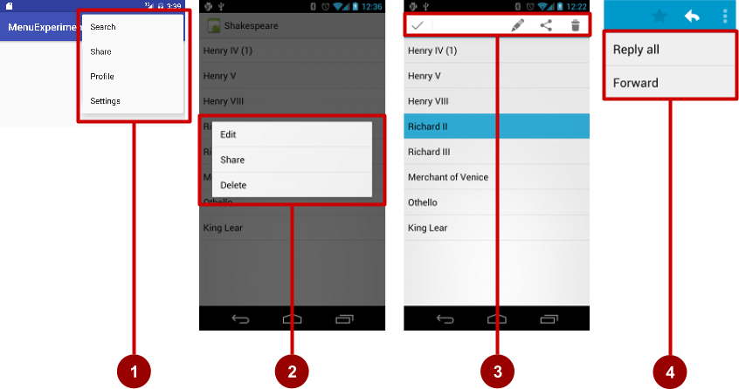
Types of Menus
App bar with options menu
Context Menu
Contextual action bar
Popup Menu

Slide 5
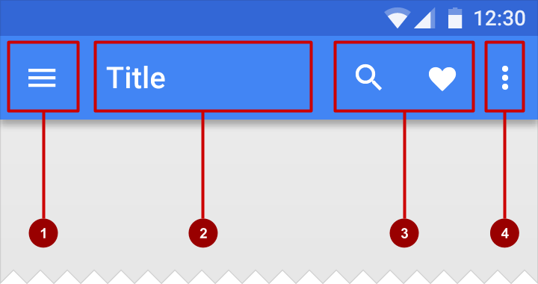
App Bar with Options Menu
What is App Bar?
Bar at top of each screen – same for all devices (usually)
1. Nav icon to open navigation drawer
2. Title of current activity
3. Icons for options menu items
4. Action overflow button for the rest of the options menu

Slide 6
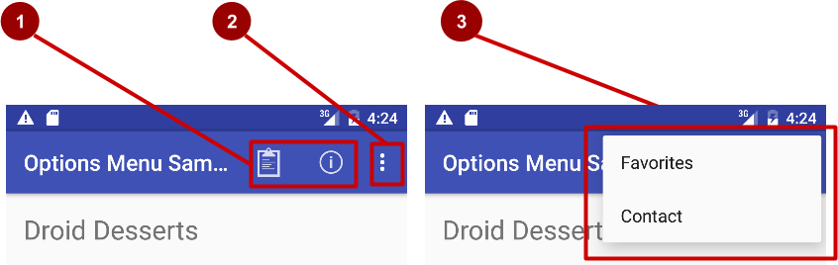
App Bar with Options Menu
What is the Options Menu?
Action icons in the app bar for important items (1)
Tap the three dots, the "action overflow button" to see the options menu (2)
Appears in the right corner of the app bar (3)
For navigating to other activities and editing app settings

Slide 7
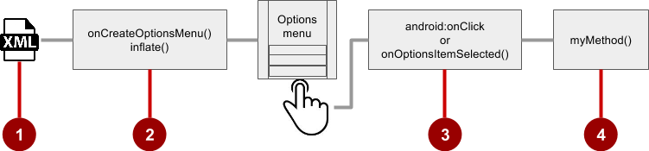
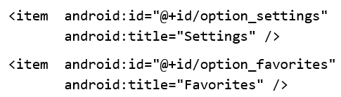
Steps to implement Options Menu
1. Create menu Resource
Create menu resource directory
Create XML menu resource (menu_main.xml)
Add Entry to each menu item (Settings and Favorites)

Slide 8
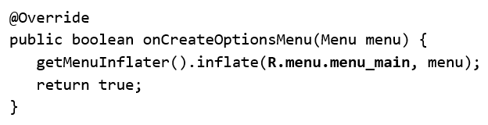
Steps to implement Options Menu
2. onCreateOptionsMenu() to inflate the menu
Override onCreateOptionsMenu() in Activity

Slide 9
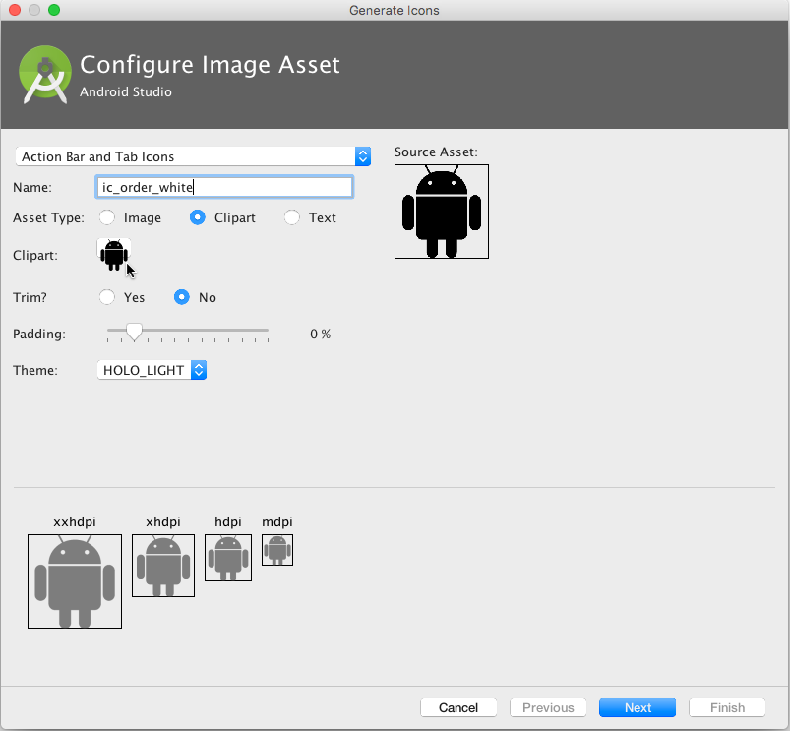
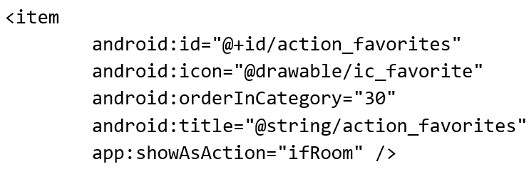
Steps to implement Options Menu
Add icons to menu items and attributes
Right-click drawable
Choose New > Image Asset
Choose Action Bar and Tab Items
Edit the icon name
Click clipart image, and click icon
Click Next, then Finish

Slide 10
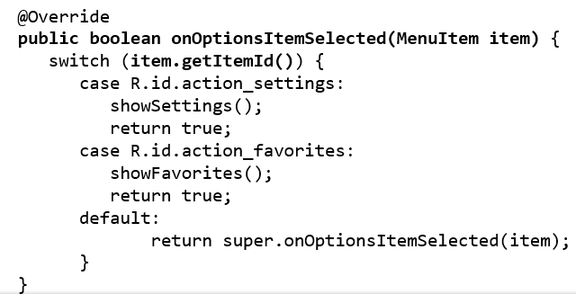
Steps to implement Options Menu
3. Override onOptionsItemSelected()

Slide 11
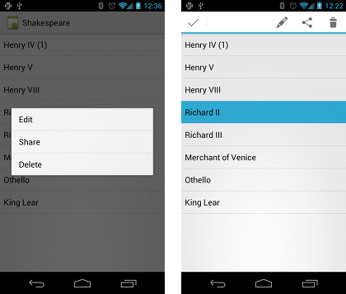
Contextual Menu
Allows users to perform action on selected view
Can be deployed on any view
Most often used for items in RecyclerView, GridView, or other View Collection
There are 2 types of contextual menus:
  Floating context menu – long press on a View
    User can modify View or use it in in some fashion
    User performs action on one View at a time
  Contextual action mode – temporary action bar in place of or underneath app bar
    Action items affect the selected View elements
    User can perform action on multiple View elements at once

Slide 12
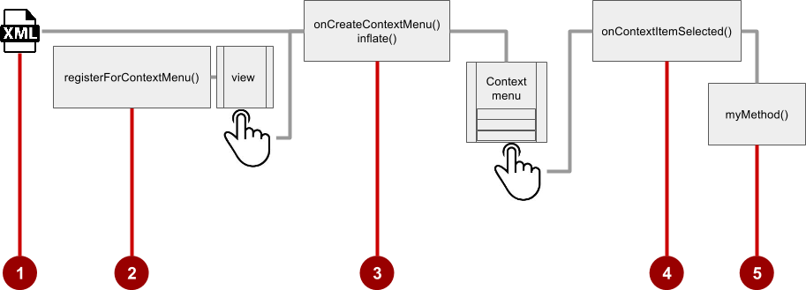
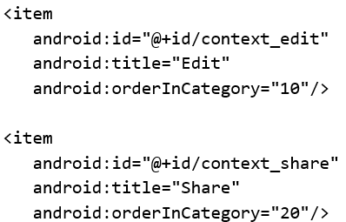
Contextual Menu
Floating Context Menu
1. Create XML menu resource (menu_context.xml)

Slide 13

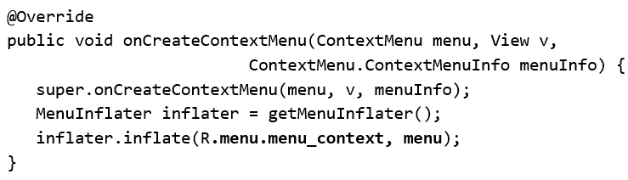
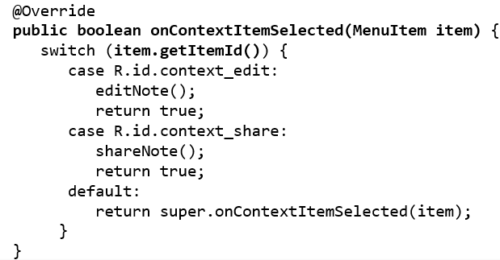
Contextual Menu
Floating Context Menu
2. Register View.OnCreateContextMenuListener to View:
in onCreate of the Activity:
3. Specify which context menu

Slide 14
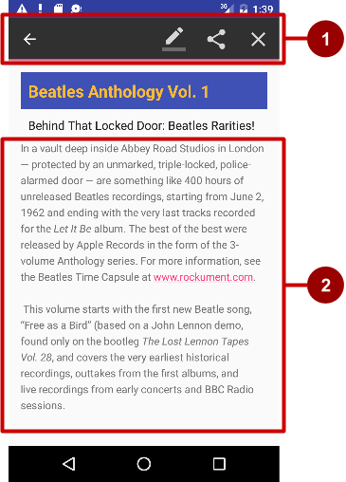
Contextual Menu
Action Bar
UI mode that lets you replace parts of normal UI interactions temporarily
Selecting a section of the text or long-pressing an item could trigger action mode.
Long press on View shows contextual action bar
  Contextual bar with actions
    Edit, share, and Delete
    Done (left arrow icon) on left side
    Action bar is available until user taps done
  View on which long press triggers contextual action bar

Slide 15
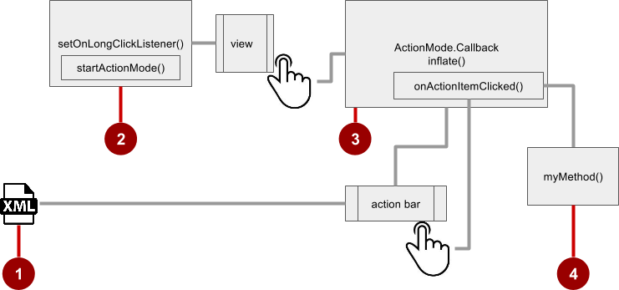
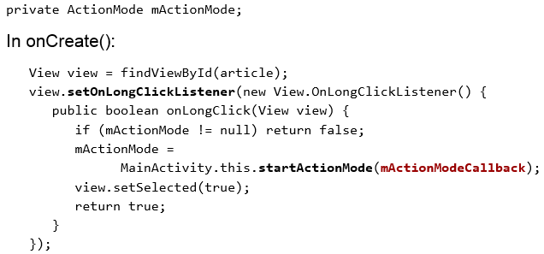
Contextual Menu
Steps for contextual action bar
Create XML menu resource file and assign icons for items.
setOnLongClickListener() on View that triggers contextual action bar and call startActionMode() to handle click

Slide 16
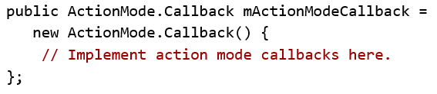
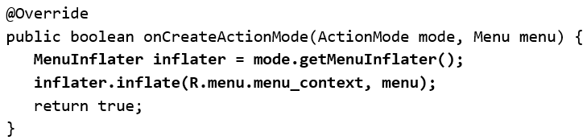
Contextual Menu
Steps for contextual action bar
3. Implement mActionModeCallback
4. Implement onCreateActionMode

Slide 17
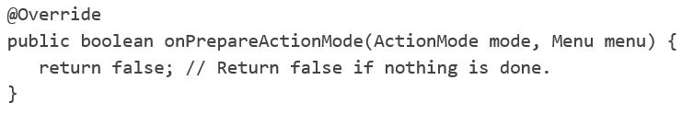
Contextual Menu
Steps for contextual action bar
5. Implement onPrepareActionMode
  Called each time action is shown
  Always called after onCreateActionMode, but may be called multiple times if action mode is invalidated

Slide 18
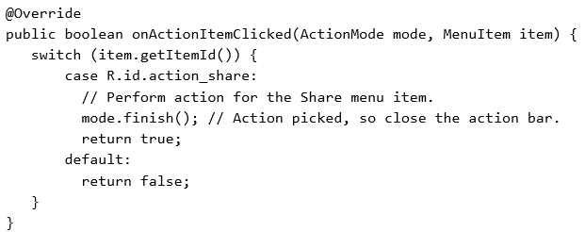
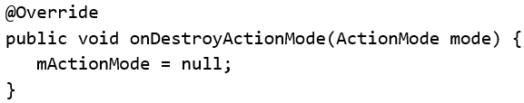
Contextual Menu
Steps for contextual action bar
6. Implement onActionItemClicked
  Called when users select an action
  Handle clicks in this method
7. Implement onDestroyActionMode

Slide 19
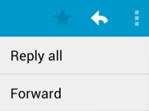
Popup Menu
Vertical list of items anchored to a view
Typically anchored to a visible icon
Action should not directly affect view content
  Option menu overflow icon that opens options menu
  In Email app, Reply All and Forward relate to email message but don’t affect or act on message

Slide 20
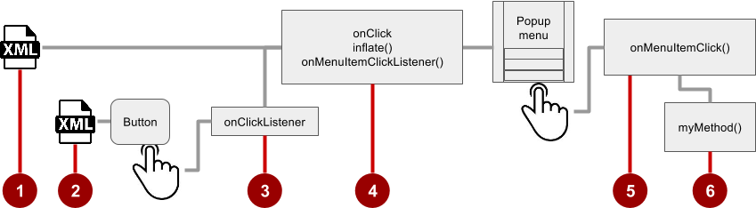
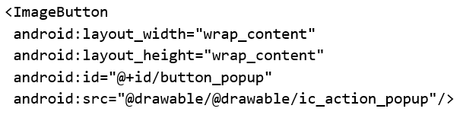

Popup Menu
Steps
Create XML menu resource file and assign appearance and position attributes
Add ImageButton for the popup menu icon in the XML activity layout file

Slide 21
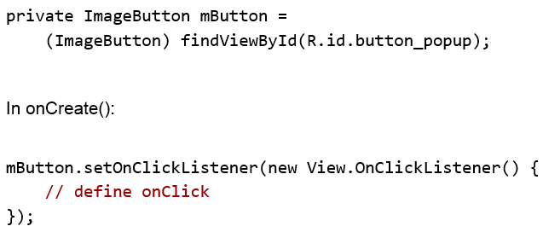
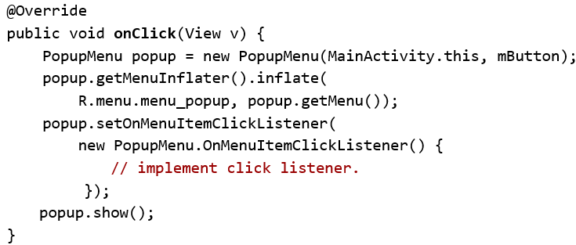
Popup Menu
Steps
3. Assign onClickListener to button
4. Implement onClick

Slide 22
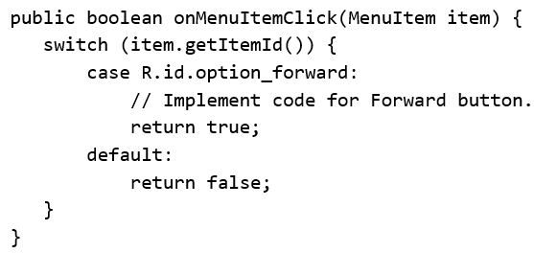
Popup Menu
Steps
5. Implement onMenuItemClick

Slide 23
Styles and Themes
A style is a collection of properties that specify the look and format for a View or window. A style can specify properties such as height, padding, font color, font size, background color, and much more. A style is defined in an XML resource that is separate from the XML that specifies the layout.
Styles in Android share a similar philosophy to cascading stylesheets in web design—they allow you to separate the design from the content.
A theme is a style applied to an entire Activity or application, rather than an individual View (as in the example above). When a style is applied as a theme, every View in the Activity or application will apply each style property that it supports. For example, you can apply the same CodeFont style as a theme for an Activity and then all text inside that Activity will have green monospace font.

Slide 24
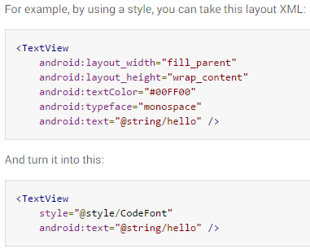
Styles and Themes

Slide 25
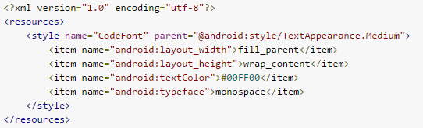
Styles and Themes - Defining Styles

Slide 26

Styles and Themes - Inheritance
You can inherit the Android platform's default text appearance and then modify it:

Slide 27


Styles and Themes - Inheritance
If you want to inherit from styles that you've defined yourself, you do not have to use the parent attribute. Instead, just prefix the name of the style you want to inherit to the name of your new style, separated by a period. For example, to create a new style that inherits the CodeFont style defined above, but make the color red, you can author the new style like this:

Slide 28
Styles and Themes - Inheritance
If you want to inherit from styles that you've defined yourself, you do not have to use the parent attribute. Instead, just prefix the name of the style you want to inherit to the name of your new style, separated by a period. For example, to create a new style that inherits the CodeFont style defined above, but make the color red, you can author the new style like this:

Slide 29

Styles and Themes – Apply a style to a View

Slide 30
Styles and Themes – Apply a theme to an Activity or Application
To set a theme for all the activities of your application, open the AndroidManifest.xml file and edit the <application> tag to include the android:themeattribute with the style name.
<application android:theme="@style/CustomTheme">
If you want a theme applied to just one Activity in your application, then add the android:theme attribute to the <activity> tag instead.
Just as Android provides other built-in resources, there are many pre-defined themes that you can use, to avoid writing them yourself. For example, if you want the background to be transparent, use the Translucent theme:
<activity android:theme="@android:style/Theme.Translucent">

Slide 31

Styles and Themes – Apply a theme to an Activity or Application
If you like a theme, but want to tweak it, just add the theme as the parent of your custom theme. For example, you can modify the traditional light theme to use your own color like this:
Now use CustomTheme instead of Theme.Light inside the Android Manifest:
<activity android:theme="@style/CustomTheme">

Slide 32
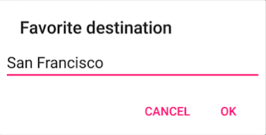
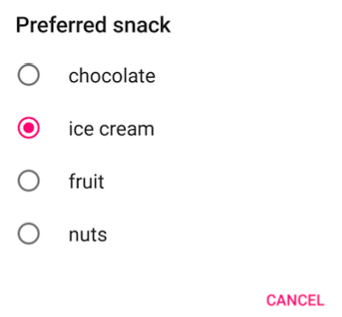

Settings
Users can set features and behaviors of app
Example:
  Home location, defaults units of measurement
  Notification behavior for specific app
For values that change infrequently and are relevant to most users
If value change often, use options menu or nav drawer.

Slide 33
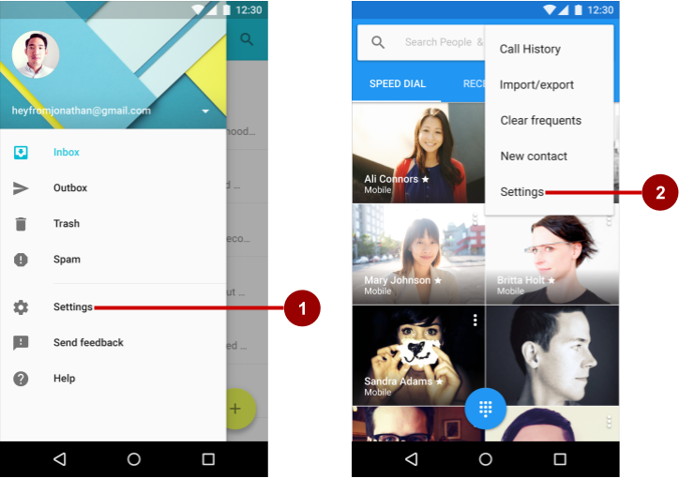
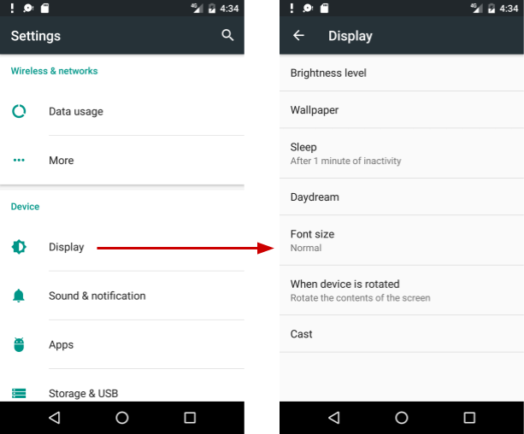
Settings
User access settings through:
  Navigation Drawer
  Options Menu
Organize your settings:
  Predictable, manageable number of options
  7 or less: arrange according to priority with most important at top
  7-15 settings: group related settings under section dividers
  16+ groups into screens opened from main settings screen

Slide 34
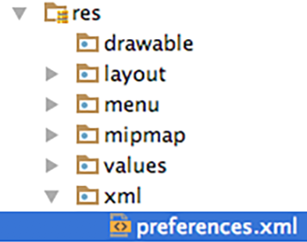
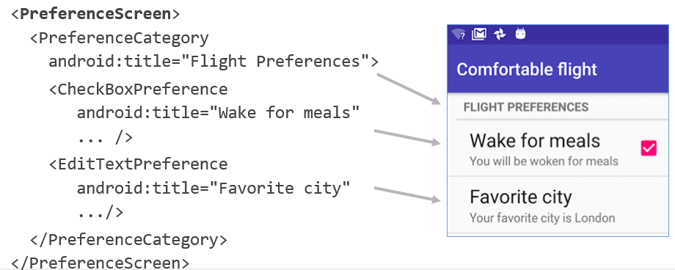
Settings
Define Settings in a Preference
Define settings in a preference screen
It is like a layout
Define in res > xml > preferences.xml
Preference screen example:

Slide 35
Settings
Building settings – Defining Preferences in XML
<?xml version="1.0" encoding="utf-8"?>
<PreferenceScreen xmlns:android="http://schemas.android.com/apk/res/android">
<CheckBoxPreference
android:key="pref_sync"
android:title="@string/pref_sync"
android:summary="@string/pref_sync_summ"
android:defaultValue="true" />
<ListPreference
android:dependency="pref_sync"
android:key="pref_syncConnectionType"
android:title="@string/pref_syncConnectionType"
android:dialogTitle="@string/pref_syncConnectionType"
android:entries="@array/pref_syncConnectionTypes_entries"
android:entryValues="@array/pref_syncConnectionTypes_values"
android:defaultValue="@string/pref_syncConnectionTypes_default" />
</PreferenceScreen>

Slide 36
Settings
Building settings – Defining Preferences in XML
android:key
  This attribute is required for preferences that persist a data value. It specifies the unique key (a string) the system uses when saving this setting's value in the SharedPreferences.
  The only instances in which this attribute is not required is when the preference is a PreferenceCategory or PreferenceScreen, or the preference specifies an Intent to invoke (with an <intent> element) or a Fragment to display (with an android:fragment attribute).
android:title
  This provides a user-visible name for the setting.

Slide 37
Settings
Building settings – Defining Preferences in XML
android:defaultValue
  This specifies the initial value that the system should set in the SharedPreferences file. You should supply a default value for all settings.
  For information about all other supported attributes, see the Preference (and respective subclass) documentation.

Slide 38
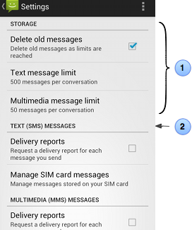
Settings
Building settings – Creating setting groups using titles
If you want to provide dividers with headings between groups of settings, place each group of Preference objects inside a PreferenceCategory.
1. The category is specified by the <PreferenceCategory> element.
2. The title is specified with the android:title attribute.

Slide 39
Settings
Building settings – Creating setting groups using titles
If you want to provide dividers with headings between groups of settings, place each group of Preference objects inside a PreferenceCategory.
1. The category is specified by the <PreferenceCategory> element.
2. The title is specified with the android:title attribute.

Slide 40
<PreferenceScreen xmlns:android="http://schemas.android.com/apk/res/android">
<PreferenceCategory
android:title="@string/pref_sms_storage_title"
android:key="pref_key_storage_settings">
<CheckBoxPreference
android:key="pref_key_auto_delete"
android:summary="@string/pref_summary_auto_delete"
android:title="@string/pref_title_auto_delete"
android:defaultValue="false"... />
<Preference
android:key="pref_key_sms_delete_limit"
android:dependency="pref_key_auto_delete"
android:summary="@string/pref_summary_delete_limit"
android:title="@string/pref_title_sms_delete"... />
<Preference
android:key="pref_key_mms_delete_limit"
android:dependency="pref_key_auto_delete"
android:summary="@string/pref_summary_delete_limit"
android:title="@string/pref_title_mms_delete" ... />
</PreferenceCategory>
...
</PreferenceScreen>
Building settings – Creating setting groups using titles

Slide 41
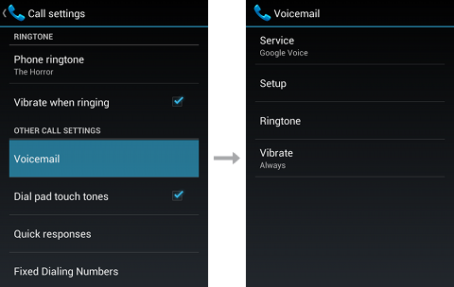
Settings
Building settings – Creating setting groups using subscreen
If you want to place groups of settings into a subscreen (as shown in figure 3), place the group of Preference objects inside a PreferenceScreen.

Slide 42
<PreferenceScreen xmlns:android="http://schemas.android.com/apk/res/android">
<!-- opens a subscreen of settings -->
<PreferenceScreen
android:key="button_voicemail_category_key"
android:title="@string/voicemail"
android:persistent="false">
<ListPreference
android:key="button_voicemail_provider_key"
android:title="@string/voicemail_provider" ... />
<!-- opens another nested subscreen -->
<PreferenceScreen
android:key="button_voicemail_setting_key"
android:title="@string/voicemail_settings"
android:persistent="false">
...
</PreferenceScreen>
<RingtonePreference
android:key="button_voicemail_ringtone_key"
android:title="@string/voicemail_ringtone_title"
android:ringtoneType="notification" ... />
...
</PreferenceScreen>
...
</PreferenceScreen>

Slide 43
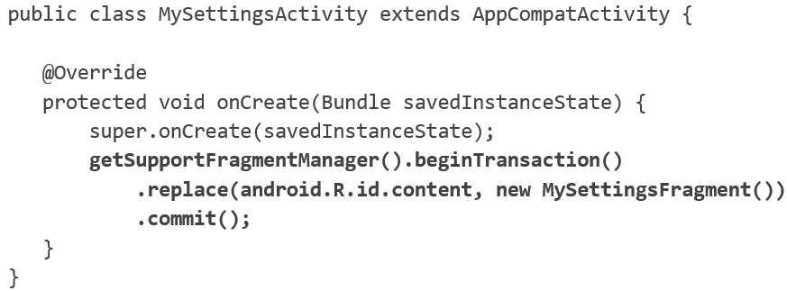
Implement Settings
Basic Activity template includes options menu
Settings menu item provided for options menu
Settings Activity

Slide 44
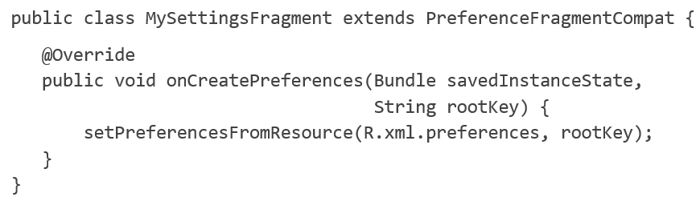
Implement Settings
Setting Fragment

Slide 45
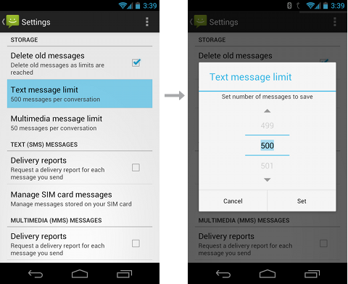
Settings
Application settings let users indicate their preferences for how an app or service should behave
Place app settings under the “Settings” label in your app’s navigation.
Controls that belong in settings should capture user preferences and be infrequently accessed. They should either affect most users or provide critical support to a minority of users.

Slide 46
References
Dawn Griffiths, David Griffiths. 2017. Head First Android Development. O'Reilly. . ISBN:978-1-4493-6213-3
https://developer.android.com/guide/topics/ui/settings.html
Android Developer Fundamental V2

